Slide 1
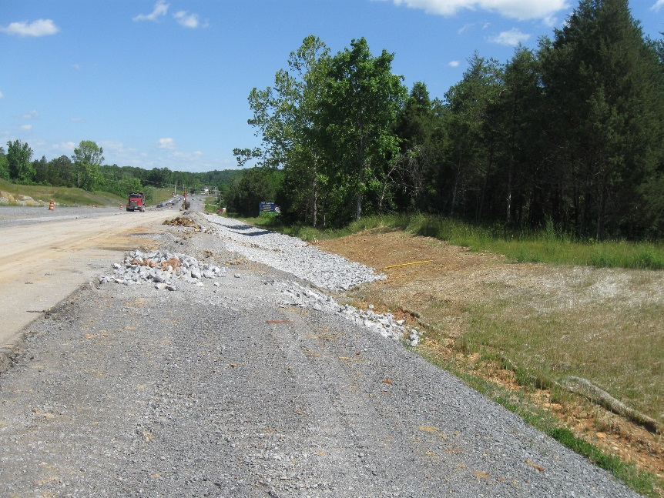
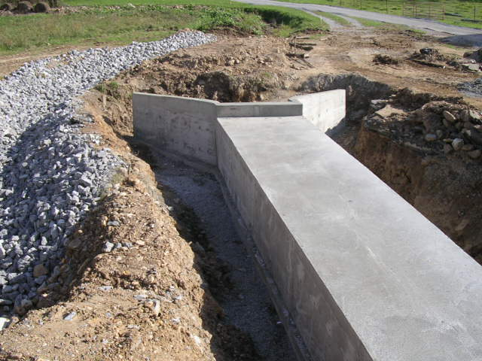
Not Your Typical Construction Site Storm Water Management
Marilyn Coffey, P.E., CPESC, CFM

Slide 2
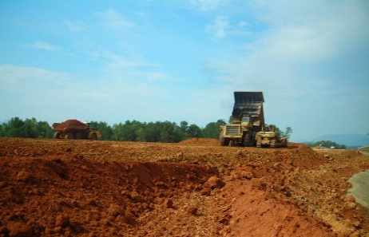
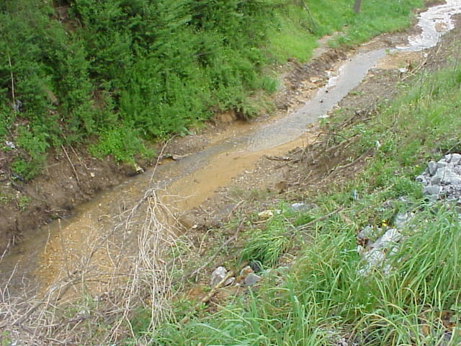
Construction site storm water management permits and practices
Many SE states (including KY)
General permits - most sites
Individual permits – as determined by KDOW, discharge to waters impaired for sediment + approved TMDL
Transportation sites (linear) differ from lots sites (non-linear)
Differences
Challenges

Slide 3
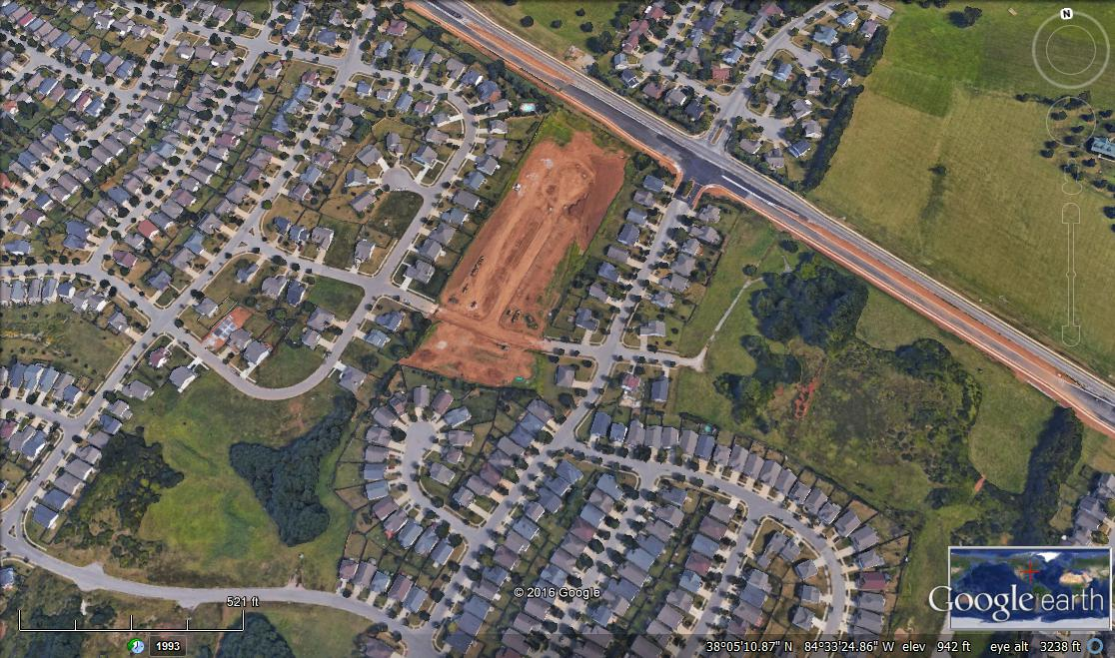
Features – Construction Site Lot
c
Notes:
Lot-style construction site
Larger construction site open for mass grading, street and utility installation
Later, individual home lot construction would follow.
Pre-construction site generally drains toward the southwest
After construction, site’s drainage may be divided depending on final grading – some may go to curb and gutter drainage along new street, some may still go toward the southwestern corner

Slide 4
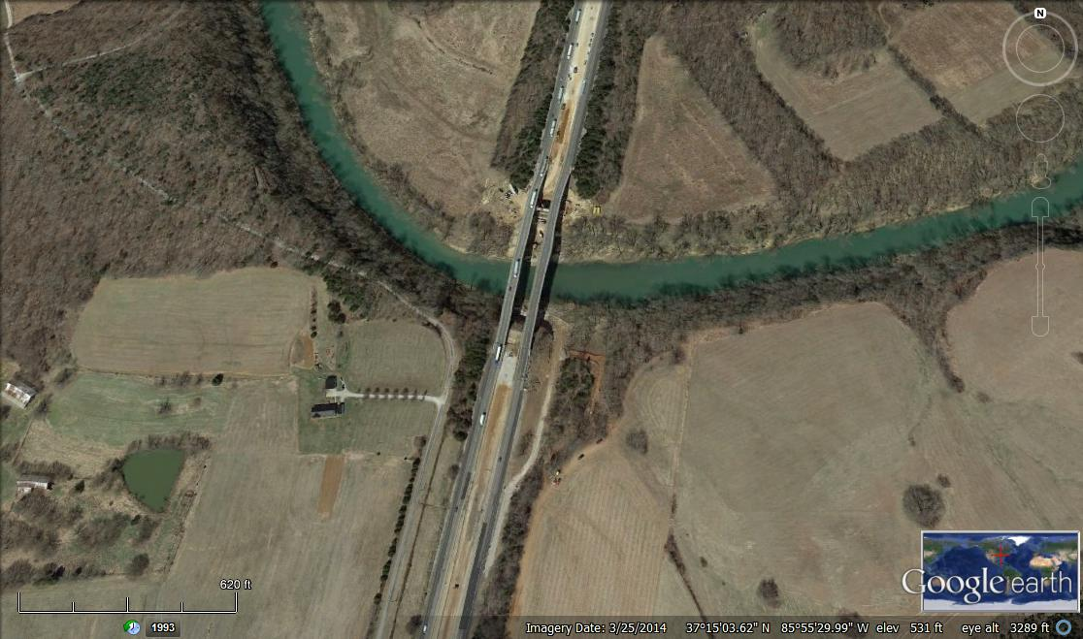
Features – Linear Construction Site
Notes:
Linear bridge construction site
Drainage generally flows toward the river
Multiple discharge points for construction storm water to the river – more locations to inspect, more potential “weak points” in erosion prevention and sediment control measures

Slide 5
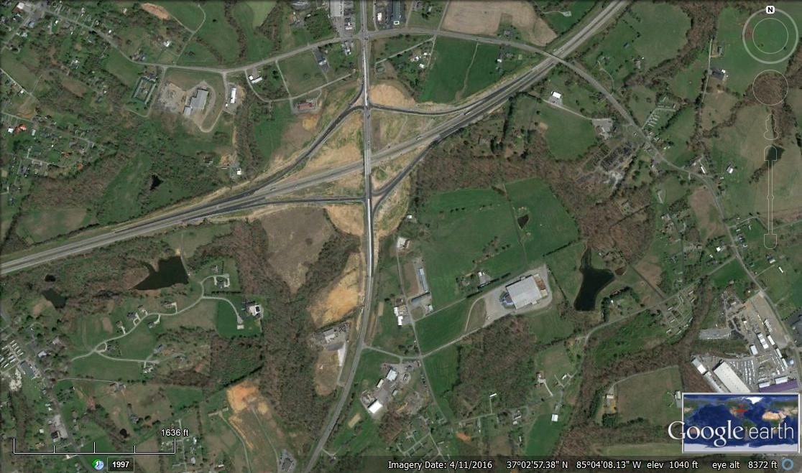
Features – Linear Construction Site
Notes:
Linear interchange construction site
The interchange is near a drainage divide between the stream to the left and another stream to the right outside the photograph
Multiple discharge points for construction stormwater – toward the stream to the left of the photograph as well as to highway drainage that discharges to the stream just outside the photograph to the right.
This site also is another example of having to inspect more discharge points, more potential “weak points” in erosion prevention and sediment control measures

Slide 6
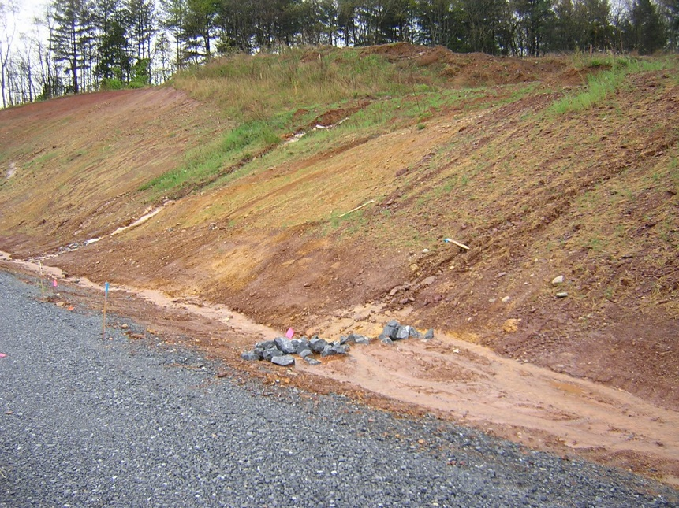
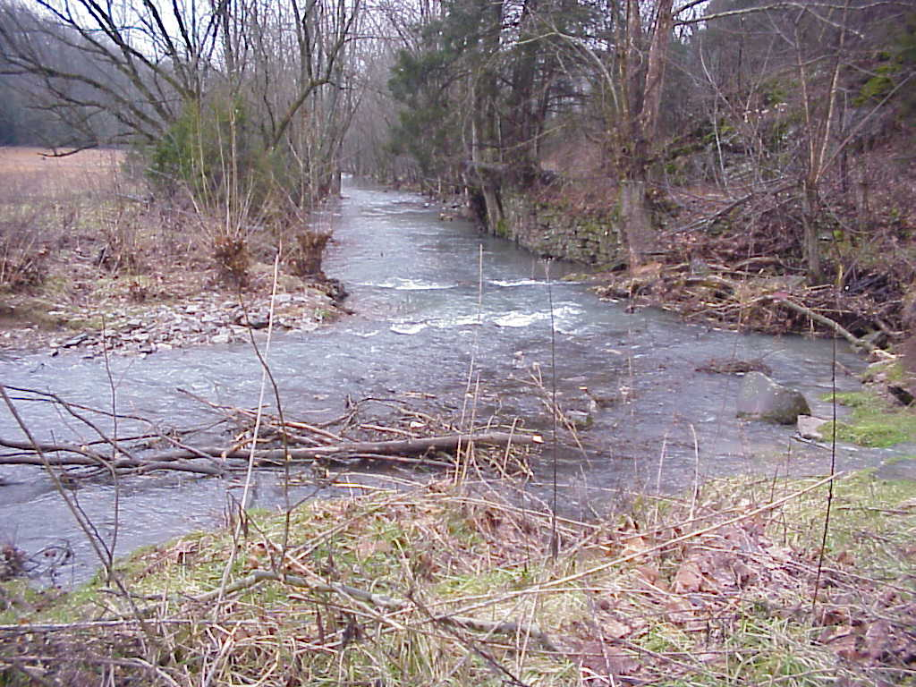
Challenge: Spatial Variations
Topography
Steep slopes
Watershed divides
Sensitive features
Streams/rivers
Wetlands
Sinkholes
Storm sewer systems
Rainfall differences
Summer “pop up” thunderstorms
Amount
Intensity

Slide 7
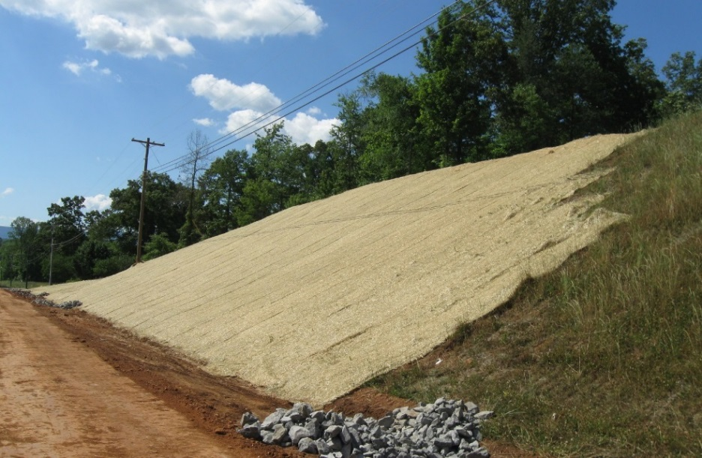
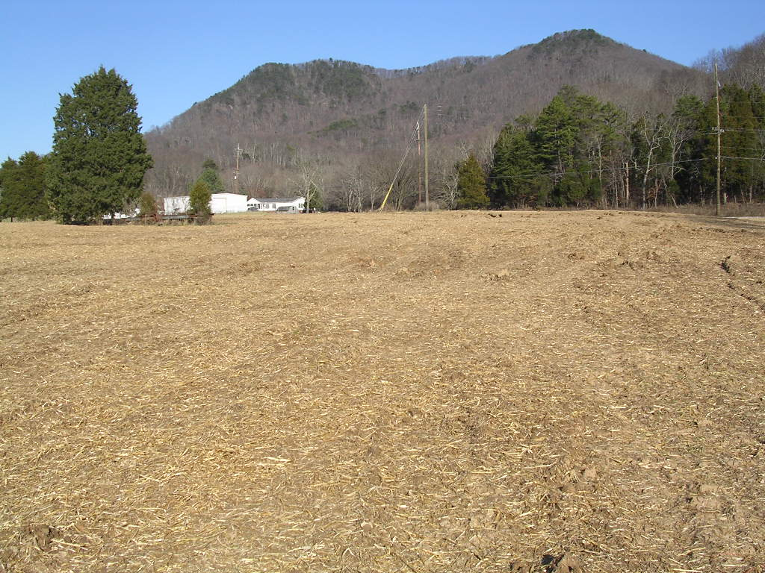
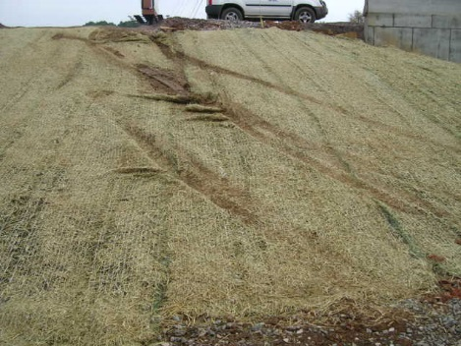
Challenge Addressed...
Topography
Finish and stabilize steep slopes early
Monitor for vegetation establishment

Slide 8
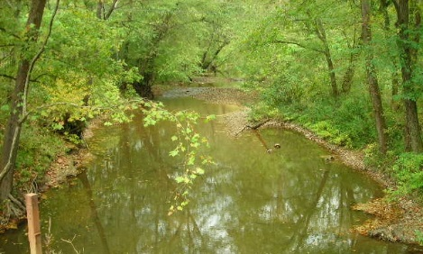
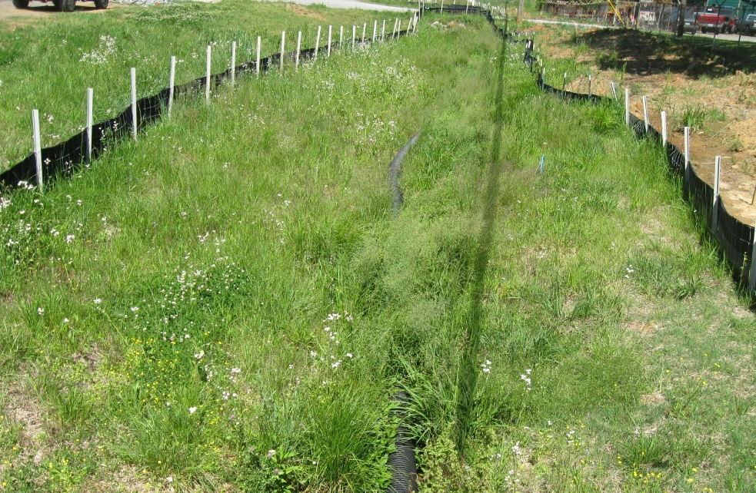
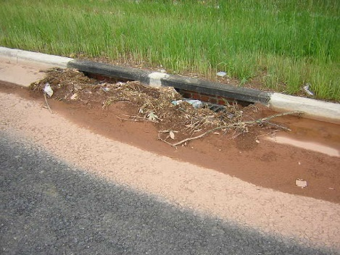
Challenge Addressed...
Sensitive features
ID key areas early in construction process (and throughout)
Plan BMPs to protect key areas
Silt fence with wire backing
Silt Trap Type C

Slide 9
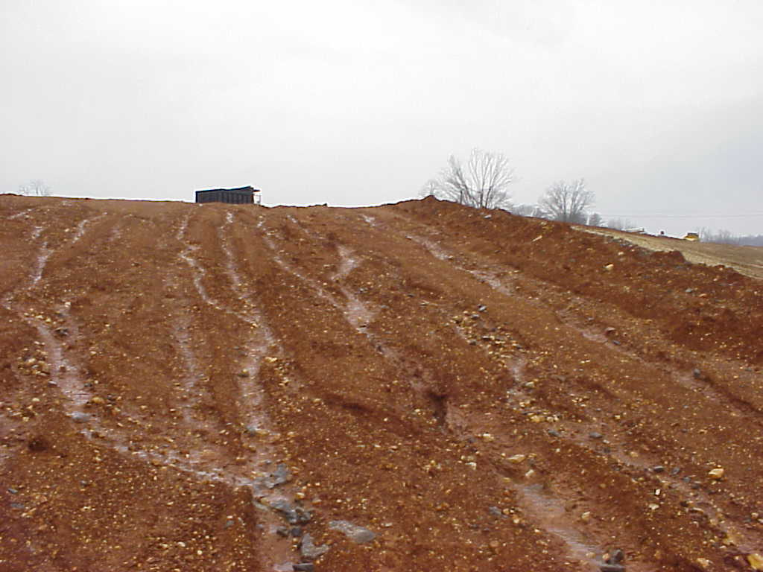
Challenge Addressed...
Consider effects of rainfall differences
Rain gage locations along alignment
Watch for variable effects along project – consider if BMP adjustments are needed

Slide 10
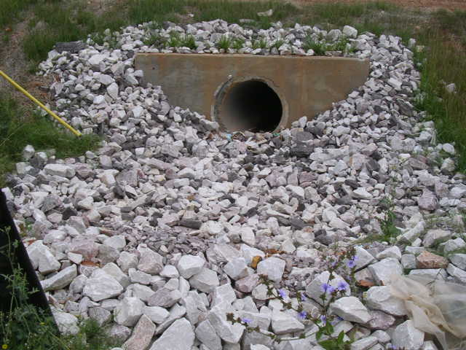
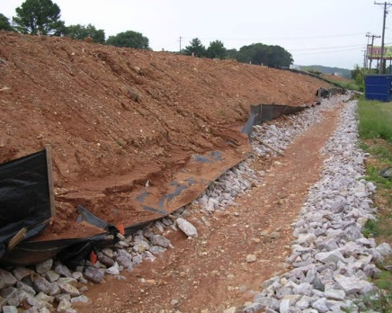
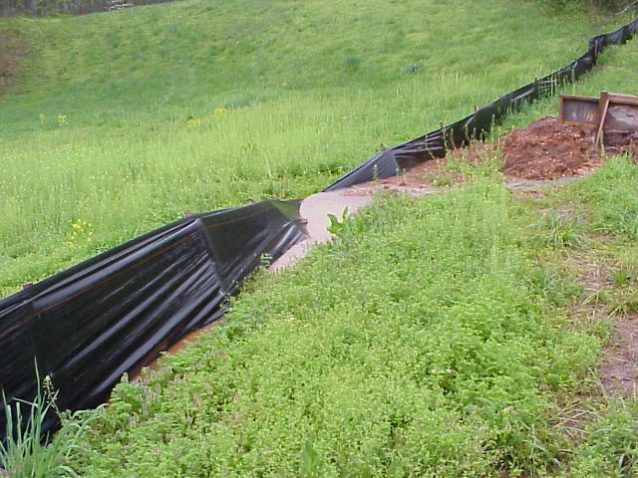
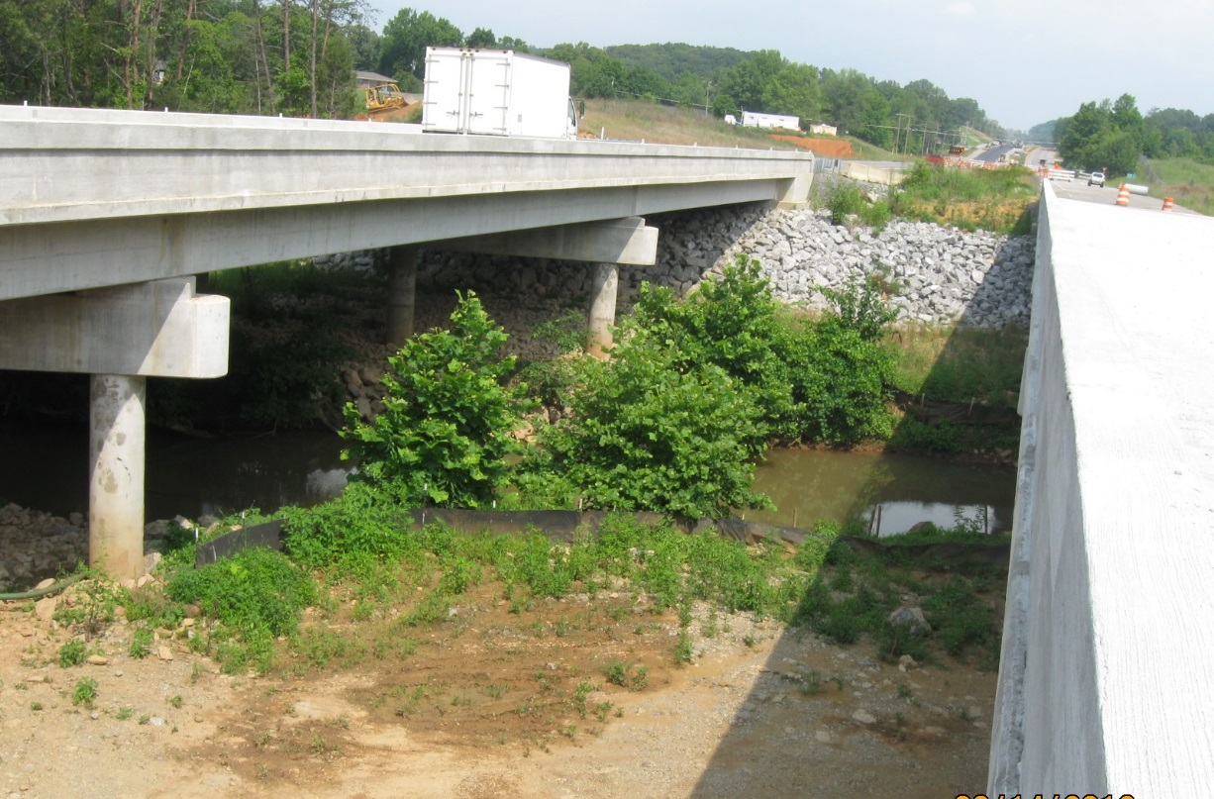
Challenge: Many Discharge Points
Corridor can cross drainage divides
Multiple streams
More potential failure points
More discharge points to ID in field

Slide 11
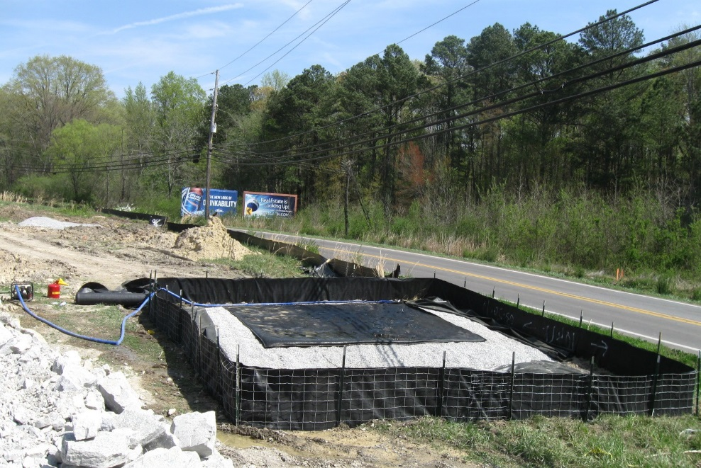
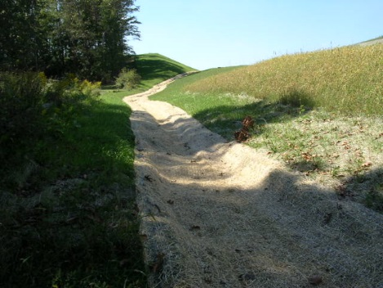
Challenge Addressed..
Multiple Discharge Points (Outfalls)
Improved BMP selection and system function – multiple lines of defense
Drainage map use and pre-disturbance inspections to ID discharge points
Targeted training for inspectors and contractors (KEPSC-RI class)

Slide 12
Challenge: Limited off-site runoff diversion
Project receives incoming runoff from upslope property
Overland flow
Incoming drainage channel (ditch, stream, etc.)
Preferred approach is to divert off-site runoff so it does not go through construction site
Protect drainage channels
Less storm water through sediment controls
Less potential erosion with less runoff over exposed soil
Limited opportunities to divert off-site water for linear sites
Corridor can hinder use of diversions such as ditches to collect and carry off-site runoff around site

Slide 13
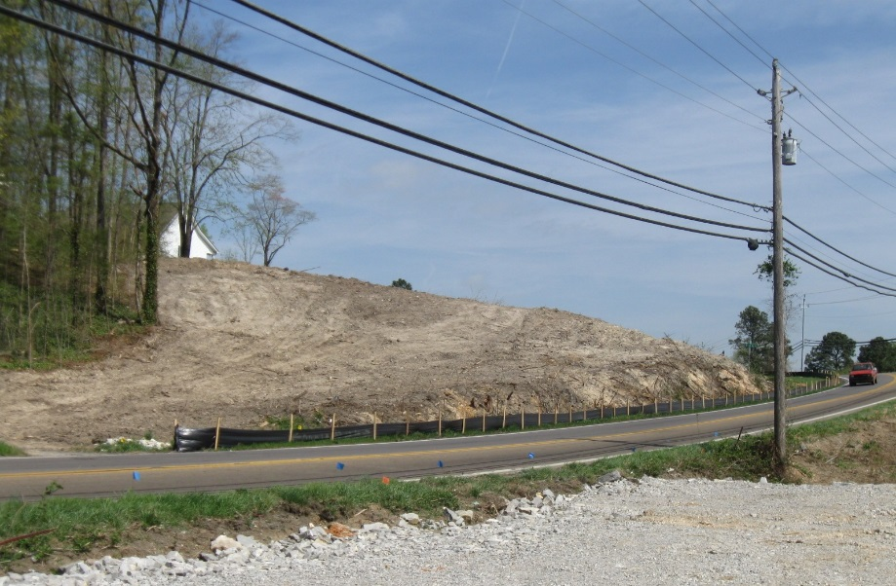
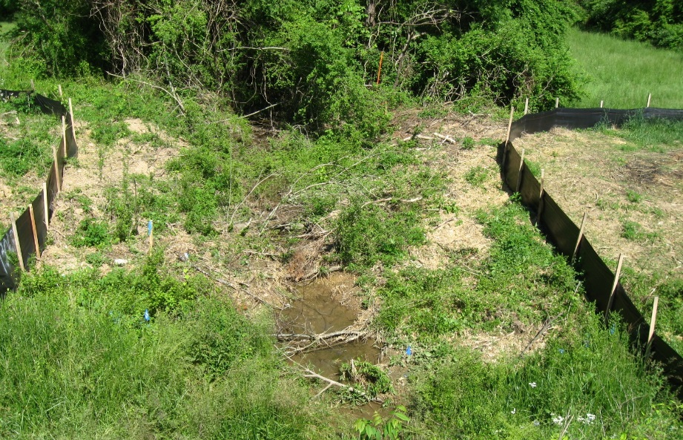
Challenge Addressed..
Look for small-scale opportunities to divert off-site runoff on corridor sites
Plan for BMP system to handle both off-site and construction site runoff where off-site water cannot be diverted
Multiple lines of defense
Larger sediment controls to accommodate more runoff
Extra attention to moving off-site runoff through construction site

Slide 14
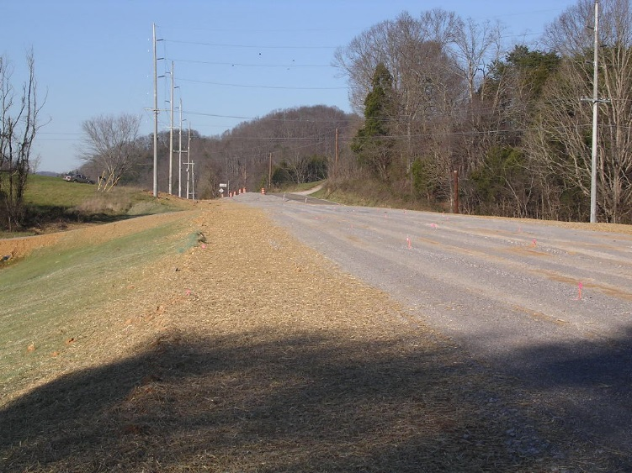
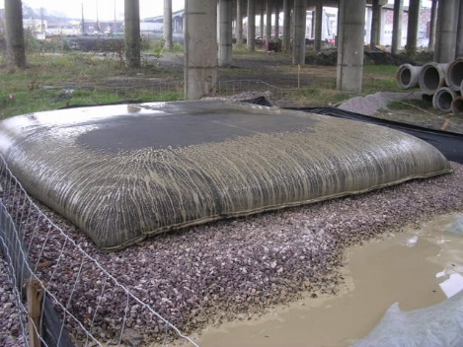
Challenge: Right-of-Way Limitations
Corridor site creates challenges for BMP selection
Expensive to acquire property
Limited room for larger BMPs such as sediment basins
Space limitations affect BMP selection, location for dewatering operations

Slide 15
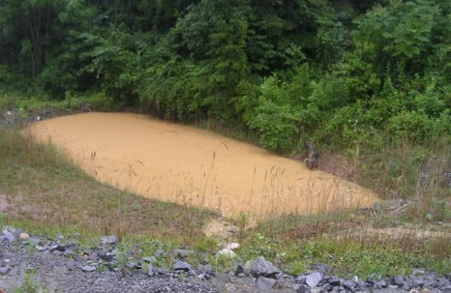
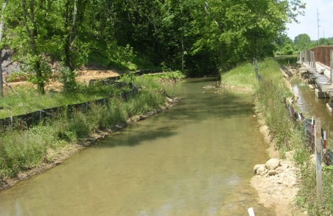
Challenge Addressed..
ROW Limitations
Divert water where feasible (reduce storm water amount to BMPs)
Install appropriate BMPs to separate construction site drainage from off-site “pass through” drainage (ditches)
Use BMP selection and system approach
Pair effective erosion controls and sediment controls
Multiple BMPs in combination instead of relying only on sediment controls at discharge points

Slide 16
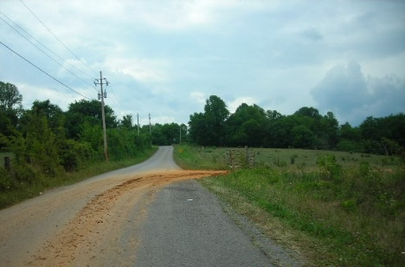
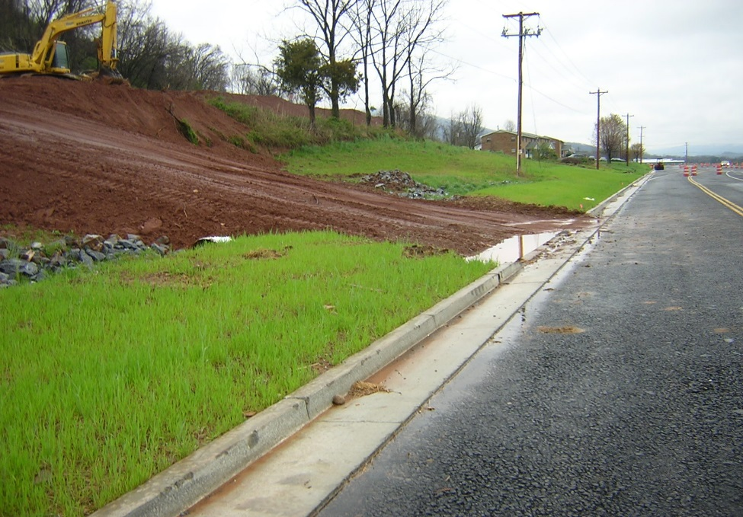
Challenge: High Visibility Project Sites
Often have traffic moving through construction site
“Windshield inspectors”
Regulators
Laymen – public better educated about storm water impacts
Limited public understanding of roadway construction

Slide 17
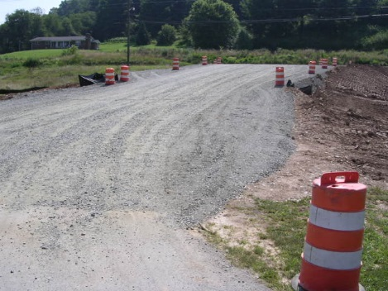
Challenge Addressed..
High Visibility Project Sites
Install and maintain construction exits – avoid drawing unwanted attention to the site due to mud track-out onto travel lanes
Extra BMP maintenance care/attention, especially adjacent to traveled areas
BMP selection to avoid BMPs that don’t work well with traffic through a construction site
KYTC Silt trap Type C - ponded water
Overflow for higher flows
May not be compatible with traffic areas

Slide 18
Challenge: Records/Communication
Maintaining appropriate site records
Keeping records current
Recognize and address communication problems/issues that affect storm water discharges from site
BMP type, sizing (such as Silt Trap Type A)
Location – station, offset
Right type of BMP for location
What caused failures, and whether BMP changes are needed as a result

Slide 19
Challenge Addressed..
Good written communication
KYTC Inspection form
KEPSC-RI training
Clear locations
Consistent with other project records (KYTC – daily work report)
Good verbal communication
Joint inspection with contractor
Inspector, contractor, subcontractor personnel
Be prepared for a regulator visit or site audit
Complete inspection form as soon as possible after inspection

Slide 20
Recap..
Linear Site Challenges
Ways to Address
Spatial variations
Many discharge points
Limited off-site runoff diversion
Right-of-way limitations
High visibility project sites
Records/communication
Finish/stabilize steep slopes
Vegetation establishment
ID key areas early and protect
Consider rain gage locations
Better BMP selection/systems
Targeted training (KEPSC-RI)
Handle off-site & on-site runoff
Install/maintain exits
BMP maintenance attention
Good written & verbal communication

Slide 21
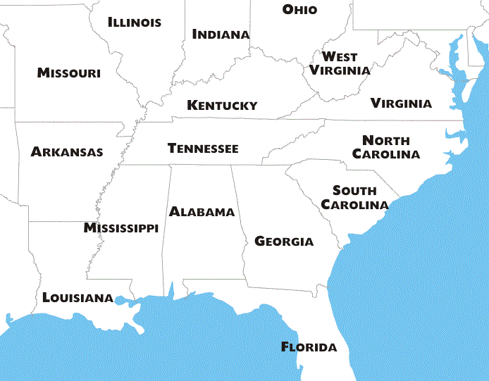
Company Overview
Founded March 1997
Woman Owned Small Business/Disadvantaged Business Enterprise
KYTC Prequalifications
Environmental and UST Services
Construction Engineering Services
Major Service Lines
Environmental Consulting
Water & Natural Resources Consulting
Construction Materials Testing
Construction Engineering/Inspection & Special Inspections
Geotechnical Engineering
Office Locations
Bowling Green, KY
Nashville & Knoxville, TN
Pensacola, FL

Slide 22
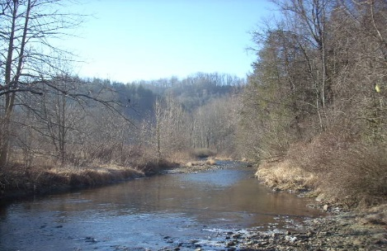
Thank You!

